Slide 1

Team Neon - Hangry Mobile
John Humlick
Daniel Tam
Aaron Escoto
Natalia Zarubin
Amir Radman

Slide 2
Hangry Food Truck Locator
System Purpose:
The primary purpose of Hangry Mobile Food Truck Locator is to allow users to locate local food trucks using an Android phone application.
This application will track coordinates of registered food trucks in real time and provide profile information for food trucks:
Goals:
Easy to use
Attract food truck operators
Attract customer user-base

Slide 3
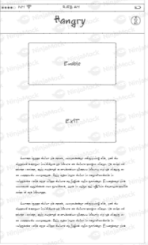
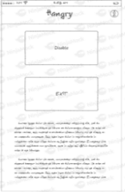
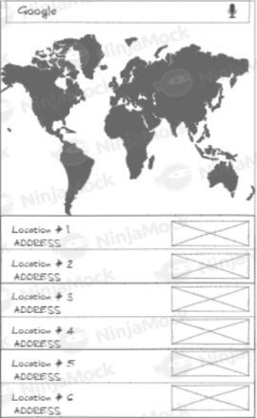
Food Truck Interface
Place your screenshot here
Place your screenshot here

Slide 4

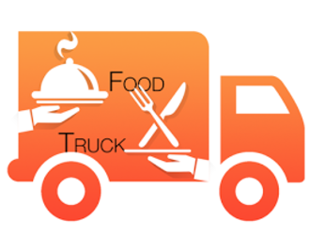

Current Solutions
FOOD TRUCKS
Limited Locations
Only serves 9 cities in Canada
Might not track in real time
No rating system
FOOD TRUCK NEARBY
No trucks nearby
Using max distance of 50 miles
UI lacking
No rating System
ROAMING HUNGER
Limited trucks nearby
Closest is SF
Doesn’t show schedule
Glitchy
Loading
Crashes
No Rating system

Slide 5
APPLICATION REQUIREMENTS
Established Internet Connection
GPS Functionality Enabled
Giving Location Permission to the Application
Requires AWS to be Operational

Slide 6
Implementation Challenges
Getting map fragment to work with linearlayout (screen division)
Display coordinates retrieved from DynamoDB on the Map (evaluate Firebase)
DynamoDB query threading
Requesting permission after android 6.0

Slide 7
RISK MITIGATION PLAN
Risk | Solutions
If AWS goes down | Display an error message
If teammate leaves | The four of us will pick up the extra work
If we lose connection | Display most recent coordinates or show an error message
If we suddenly get a large amount of users | AWS has autoscaling

Slide 8
DEMO!

Slide 9
Android app that resides with a Mobile Tracker
Moving parts of the tracking system: Android app that's installed on Android devices and deployed on the tracked vehicles.
Once configured, this app keeps its location synced with Firebase in real time and reports on other metrics, such as battery life.
There is Node.js server which receives the locations reported by the driver-side Android app, along with a time table provided in GTFS format, and makes regular updates to a Firebase Real Time Database

Slide 10
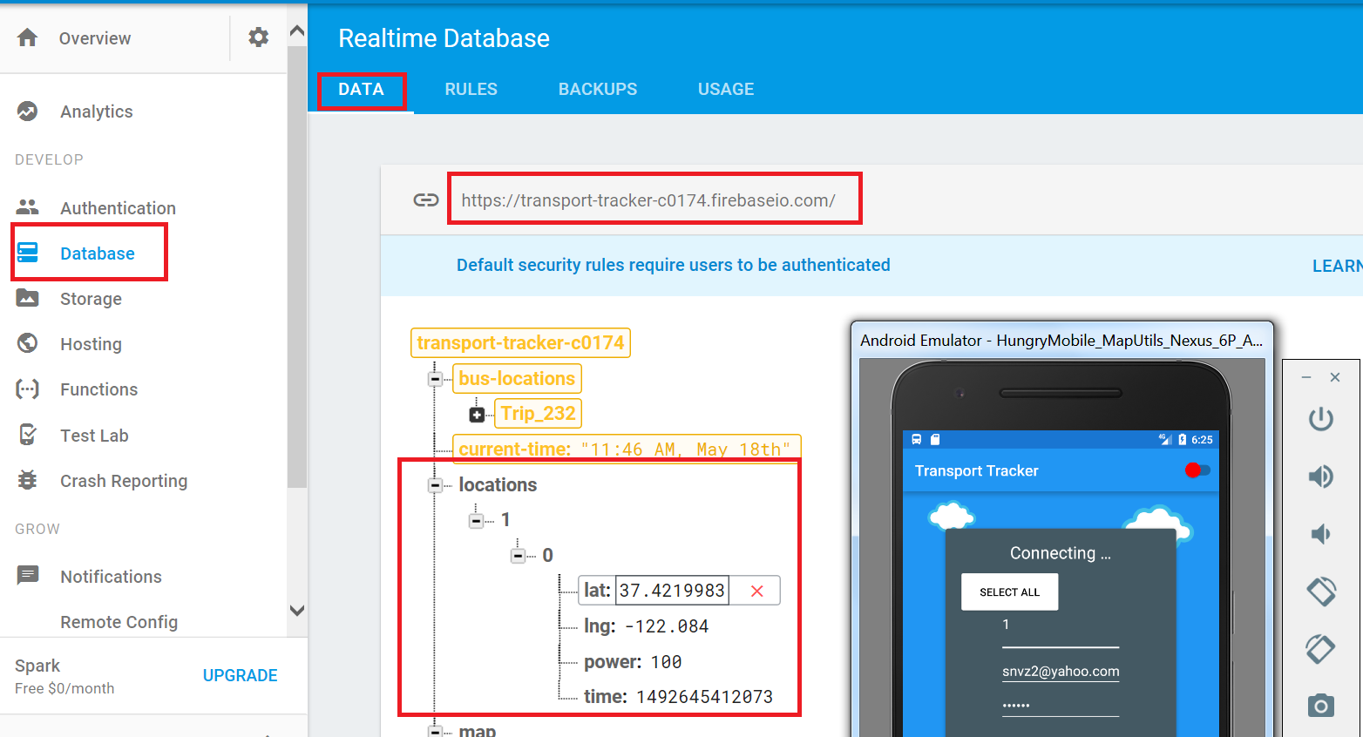
Mobile Vehicle Tracking in Real Time

Slide 11
Android app that resides with a Mobile Tracker

Slide 12
Multiple Vehicles Tracking and GTFS

Slide 13
Android app that resides with a Mobile Tracker

Slide 14
Questions?

